Slide 1
Creating an Employee Performance Scorecard in Excel
STUDENT NAME: PRAVEEN KUMAR G
REGISTER NO: 312214538(A63C49CB3C24A72B3344B0F432452681)
DEPARTMENT: B.COM(COMPUTER APPLICATION)
COLLEGE: ST.THOMAS COLLEGE OF ARTS AND SCIENCE

Slide 2
PROJECT TITLE
Creating an Employee Performance Scorecard in Excel

Slide 3


AGENDA
Problem Statement
Project Overview
End Users
Our Solution and Proposition
Dataset Description
Modelling Approach
Results and Discussion
Conclusion
3/21/2024 Annual Review

Slide 4

PROBLEM STATEMENT
Our organization currently faces challenges in consistently and objectively evaluating employee performance. The absence of a standardized performance assessment tool leads to inconsistencies across teams
This inconsistency in performance evaluation results in unclear feedback, diminished employee morale, and potential bias in performance reviews
To address these issues, there is a need to develop an employee performance scorecard that provides a structured and objective framework for evaluating employee performance

Slide 5

PROJECT OVERVIEW
Employee Information Sections for employee name, position, department, and review period, Performance Metrics Columns for each KPI, criteria, and target benchmarks.
Scoring System A method for rating performance (e.g., numerical scores, letter grades).
Comments/Feedback Area for qualitative feedback and observations

Slide 6

WHO ARE THE END USERS?
HR Managers: They often design and manage the scorecard to ensure it aligns with organizational goals and performance metrics
Team Leaders/Supervisors: These individuals use the scorecard to assess their team members' performance, provide feedback, and make decisions related to promotions, raises, or professional development.
Employees: They are the subjects of the scorecard. Employees use it to understand how their performance is evaluated, which can help them improve and align their efforts with organizational

Slide 7

OUR SOLUTION AND ITS VALUE PROPOSITION
Our solution is a customized Employee Performance Scorecard designed in Microsoft Excel.
It provides a comprehensive framework for evaluating and tracking employee performance based on a set of predefined metrics and criteria.
The scorecard is built to be user-friendly, flexible, and easily integrable into existing performance management processes.

Slide 8
Dataset Description
Kaagle- employee dataset
26 feature
9 features
Emp id-numerical
Fn-text
Ln-text
Business unit-text
Gender-male, female
Performance score-text
Rating- numerical(5,4,3,2)

Slide 9

THE "WOW" IN OUR SOLUTION
=IFS(Z8>=5;”VERY HIGH”, IFS(Z8>=4,”HIGH”, IFS(Z8>=3,”MED”,TRUE,”TRUE,”LOW)
3/21/2024 Annual Review
9

Slide 10
MODELLING
Modeling an Employee Performance Scorecard in Excel involves creating a well-structured and dynamic spreadsheet that facilitates accurate performance evaluation and tracking. Here’s a step-by-step guide to model your scorecard:
Sheets and Sections
Sheet 1: Employee Data
Sheet 2: Performance Metrics
Sheet 3: Evaluation and Scoring
Sheet 4: Dashboard/Report
10

Slide 11
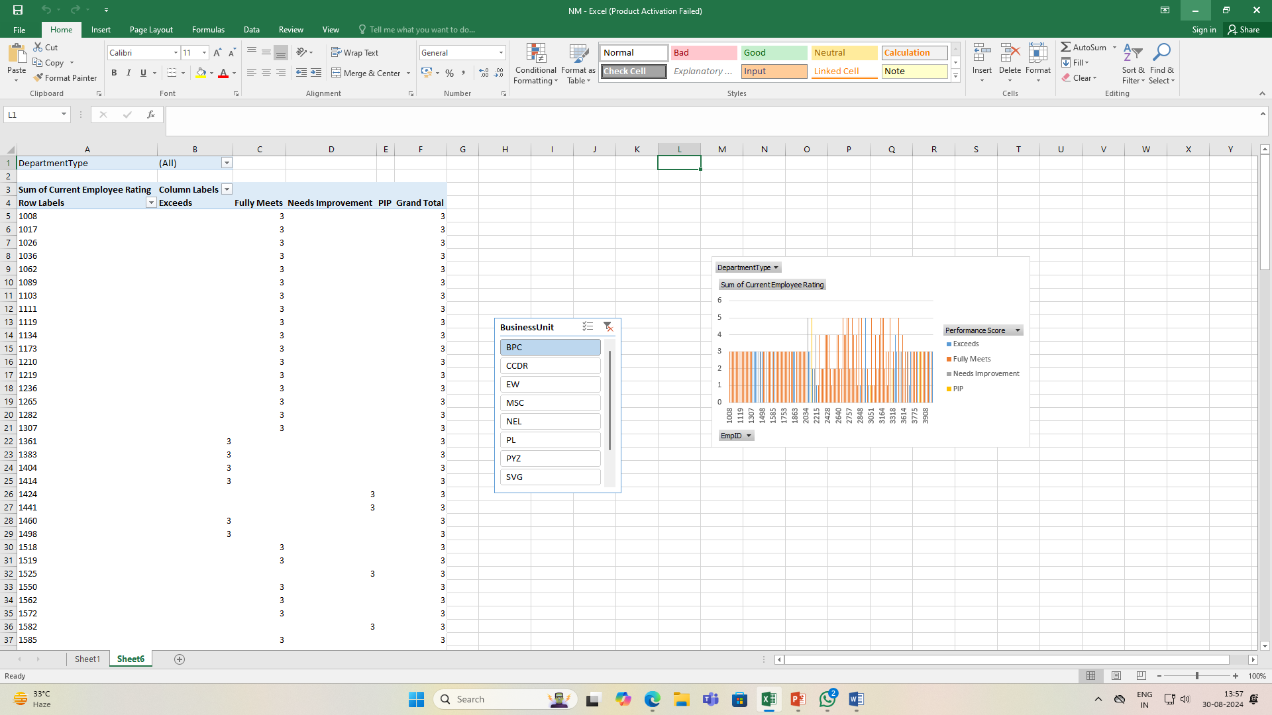
RESULTS

Slide 12
RESULTS
12

Slide 13
conclusion
Developing an Employee Performance Scorecard in Excel is a powerful way to systematically assess, track, and enhance employee performance. By leveraging Excel’s capabilities, you can create a dynamic and user-friendly tool that provides valuable insights and facilitates informed decision-making. Here’s a summary of key points and benefits

